Slide 1

NLP Based Question & Answers
for
E-commerce
Group 1
Mentors: Karthick & Parth
04/05/2020
Amit shende
Johny jose
Priyadarshini
Saranya
Vivek karthick

Slide 2
Business Objective:
An e-commerce company wants to build an algorithm to retrieve top 5 Question and answers based on the user given Keyword.

Slide 3
Project Architecture / Project Flow
Data source
Preprocessing
Feature Engineering
Stopword removal
Lowercasing
Tokenization
Lemmatization
In question and answer columns
Bag of words containing keywords for
TF-IDF
model
Cosine similarity
&
TF-IDF
model
Json file to dataframe
Deploying the model
Using flask
Building Recommendation of question and answer for the user input based on the similarity scores
Deployment
Model building
& prediction

Slide 4
Exploratory Data Analysis (EDA) and
Feature Engineering
Checking the available data, using functions such as describe, index, dtype.
Checking and handling Null values, unique values.
Counting the number of characters in question and answer columns by rows.
Part of speech Features for the question and answer column
Creating a word cloud for Answer and Question text.
Creating Most common Bigrams and Trigrams for positive phrases.
Finding the polarity in the Question and Answers
Visualizing the polarity sentiments.
Change the reading file name to df2_1 to df2_2 and on...to df2_4
Remove the lines which don't have keywords after cleaning the data
Change the saving file name to df3_1 to df3_2 and on... to df3_4

Slide 5
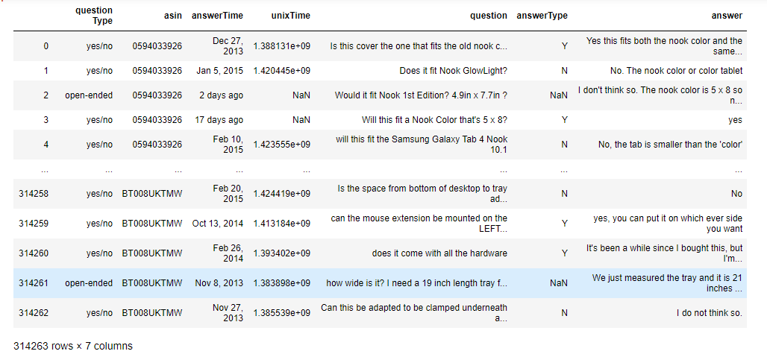
Data set details
Rows =314263, columns =7 and unique values= 0.9375
NAN values = UNIX Time : 9389,answerType : 148654,
answer : 32

Slide 6
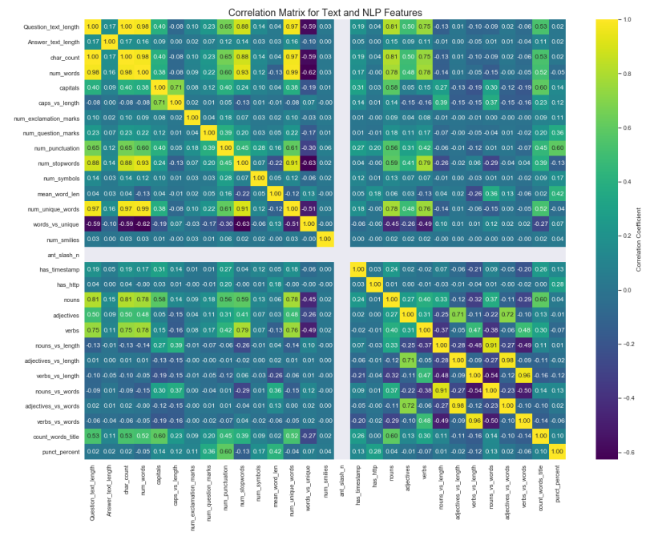
Exploratory Data Analysis (EDA)

Slide 7
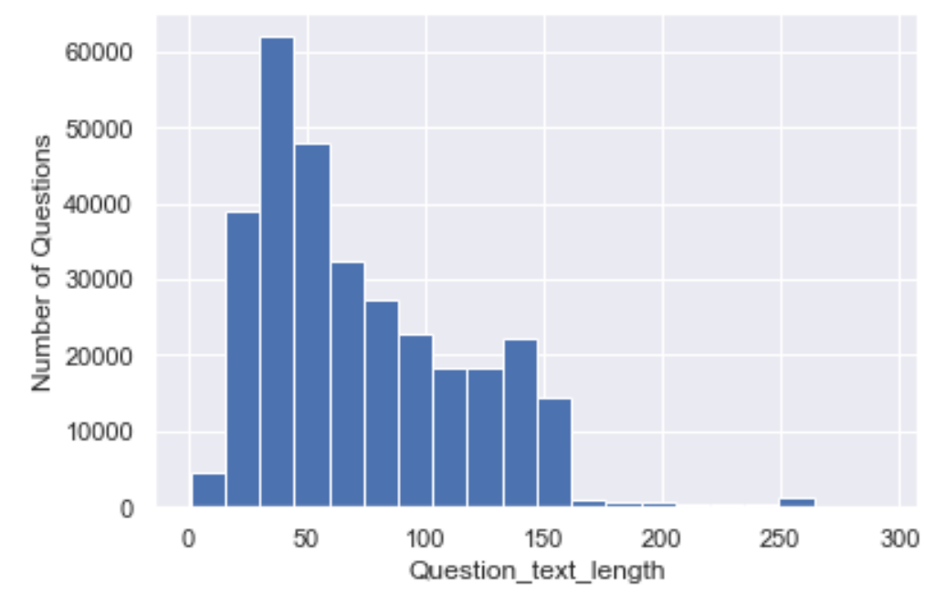
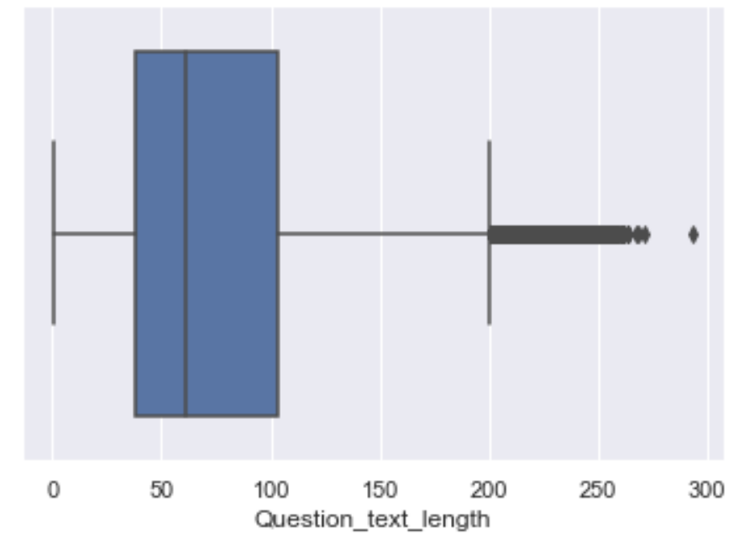
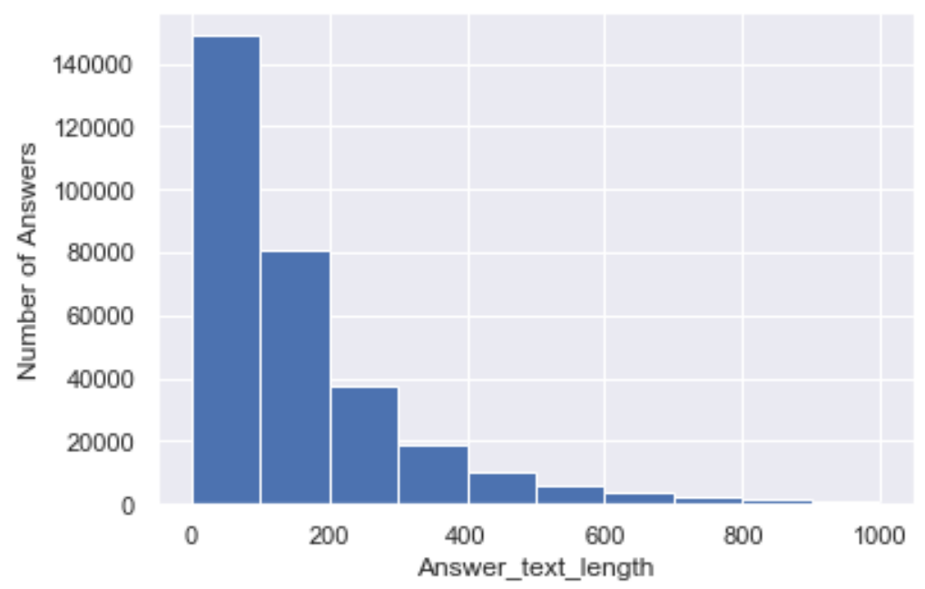
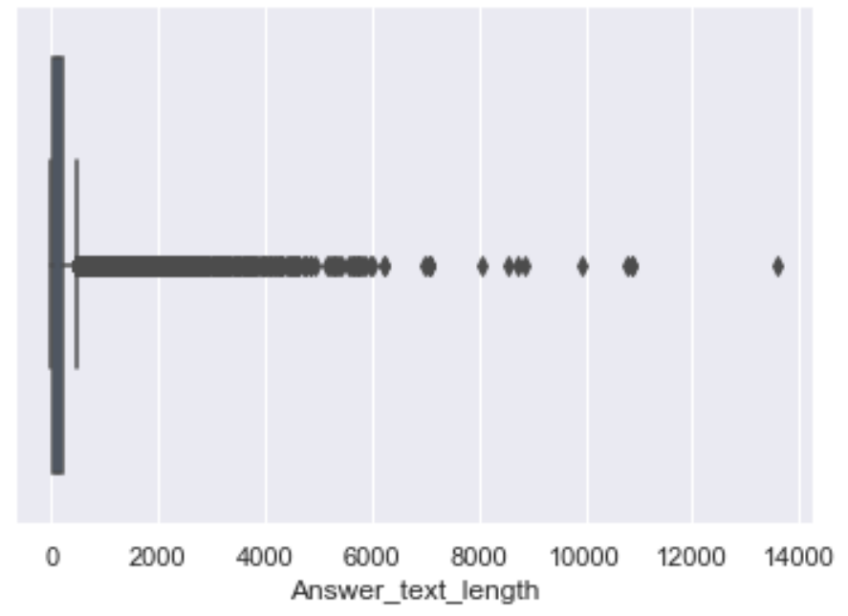
Average word length of phrases in Question is 14.
Average word length of phrases in Answer is 32.

Slide 8
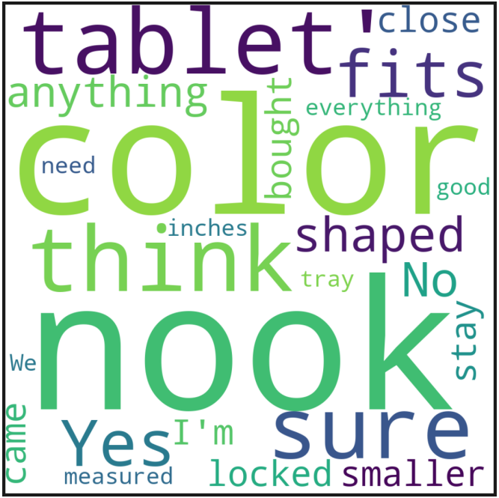
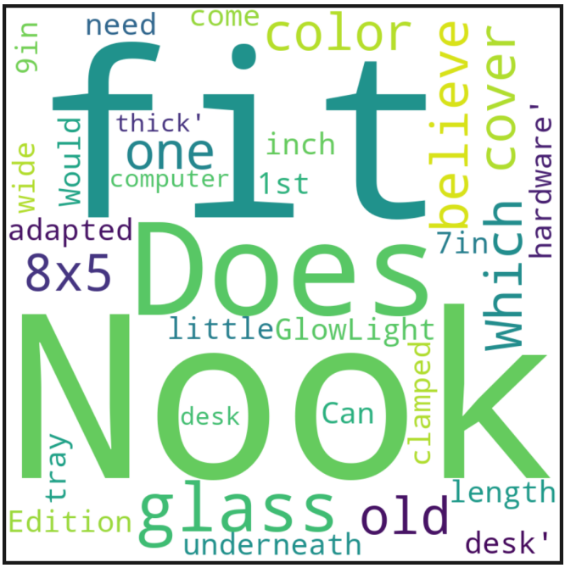
EDA
Stopword removal ,lowercasing ,tokenization ,lemmatization ,bigram and trigram are done in the question and answer columns .
After the preprocessing of the question and answer columns we created the word clouds for keywords .then the bag of words is generated.
Word cloud for Answer Word cloud for Question

Slide 9
Feature Engineering
As the model have to recommend top 5 question and answer ,we create a dictionary of words from keywords
dictionary = Dictionary(processed_docs)
Create corpus where the corpus is a bag of words for each document.
corpus = [dictionary.doc2bow(doc)for doc in processed_docs]
Tf-Idf is a technique that assigns scores to words inside a document.
Create tfidf model of the corpus
tfidf = TfidfModel(corpus)
Create the similarity data structure.
sims = MatrixSimilarity(tfidf[corpus], num_features=len(dictionary))
This is the most important part where we get the similarities between the Question and Answers

Slide 10
Model Building

Slide 11
Template for Model results presentation Model-Cosine Similarityodel Model Model - Model -Model -
Data set details:
314091 Rows and 5 columns
Algorithms:
Recommendation system based algorithm
Similarity Score:
based on the keyword

Slide 12
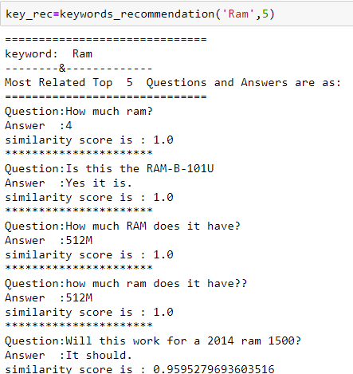
Model Results
Model generated for the question keyword converted into regular bag of words to a tf- idf model.
Finding similarity between the data an keyword. Based on keyword similarity retrieved top 5 question and answer

Slide 13
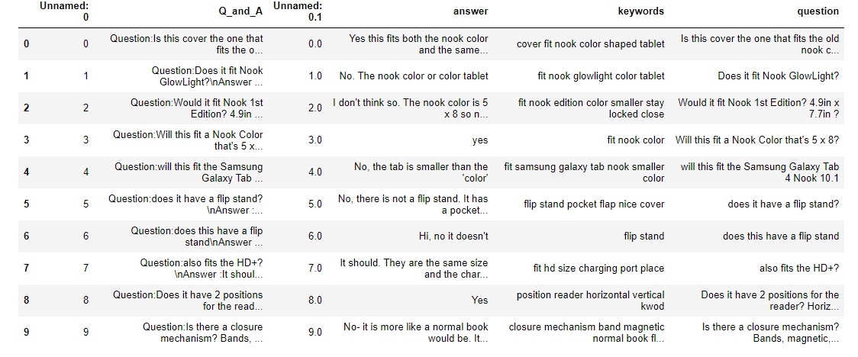
Model Predictions retrieved top 5 Question and answers Based on keyword retrived

Slide 14
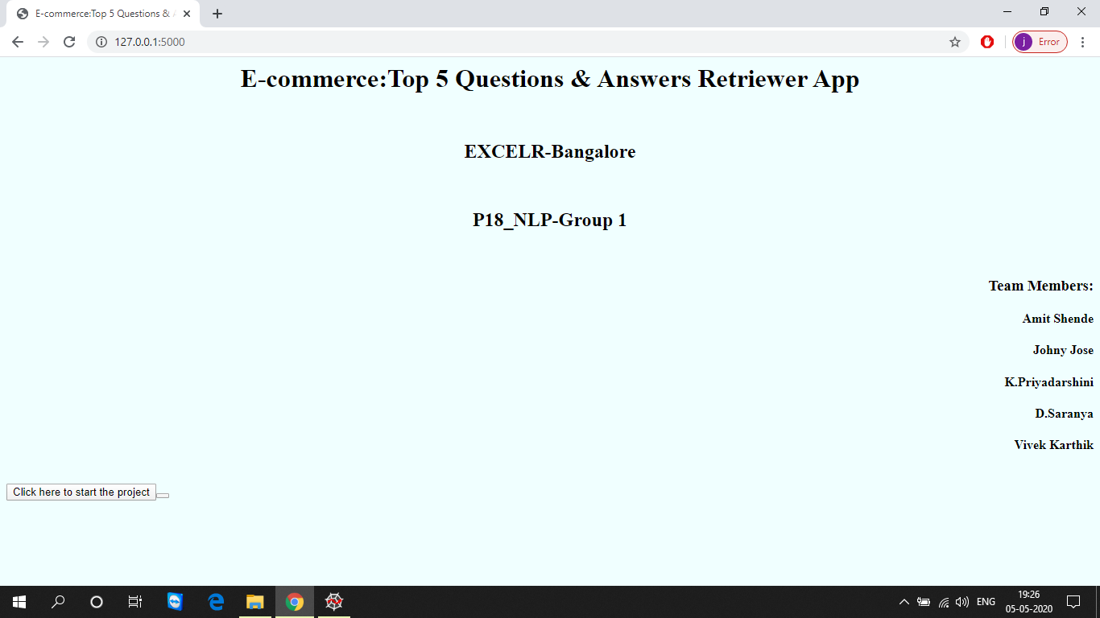
Model Deployment using Flask
first page of deployment , user has to click “start search”

Slide 15
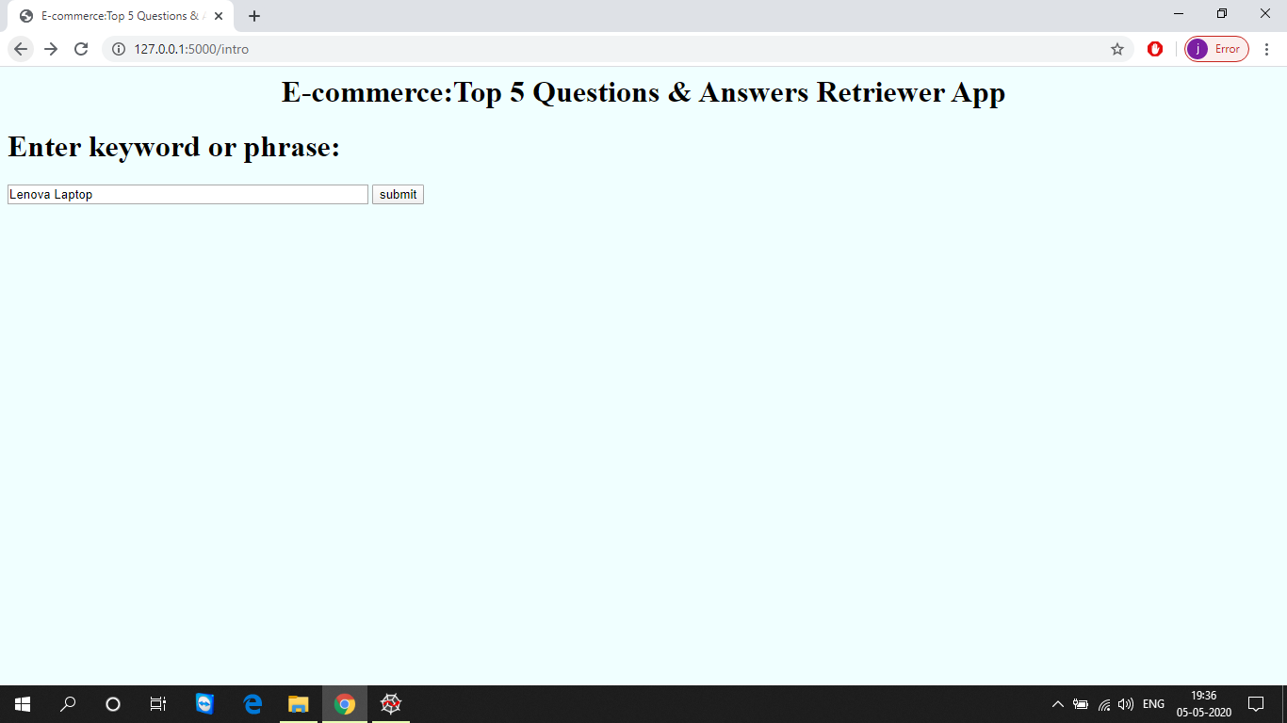
Model Deployment using Flask
Second page of deployment ,here user have to enter the text which is to be searched

Slide 16
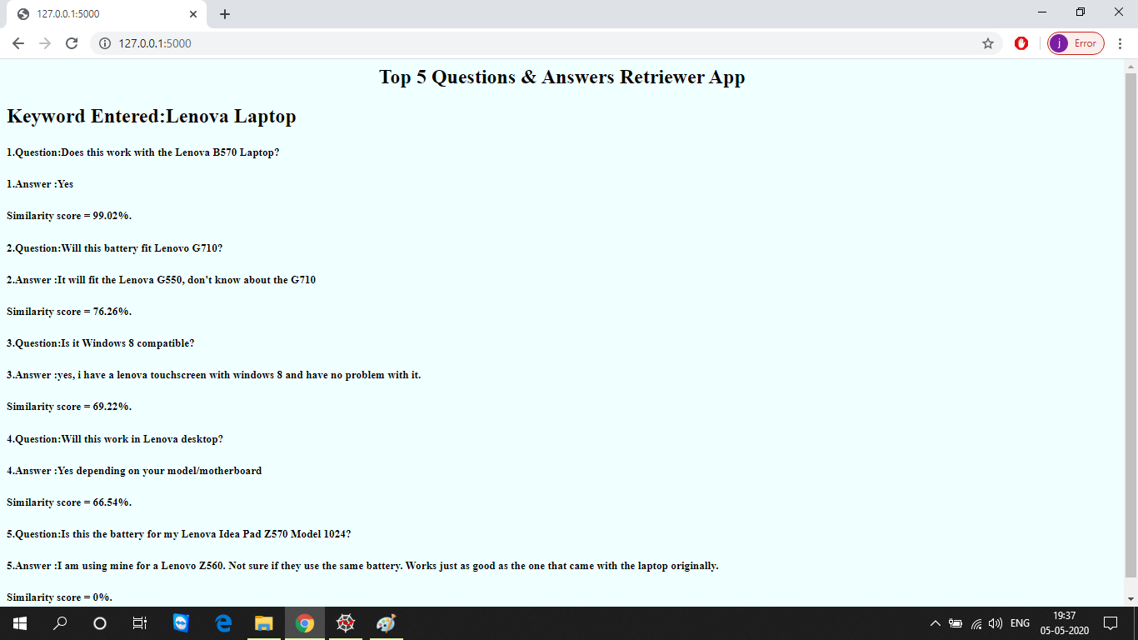
Model Deployment using Flask
Last page of the deployment comes after the user given “submit”

Slide 17
Challenges faced
We first struggled in converting the json file to dataframe,then by referring many blogs we solved it
After cleaning the data ,while generating the keywords we came up with some meaning less words .so,we cleaned the data again.
We implemented different methods to generate keyword,like RAKE function etc.,
We got Memory error in tfidf vectorizer and we made many researches on that.
We discussed with our project mentors and also refered the pages related to the error.
Referred link:
https://medium.com/@AgenceSkoli/how-to-avoid-memory-overloads-using-scikit-learn-f5eb911ae66c
And we solved the issues and made the model.

Slide 18
Thank you

